Slide 1
HOOPP overview

Slide 2
Agenda
ITFS Principle & Vision (Reno)
IT Vision/Strategy, Expectations
Main Divisions (Albert)
IT & Facilities Services – (Albert)
IT-IA (IT Investment Applications)
Main Business Units and their relationship to IT-IA
Front Office: Albert
Mid Office: Ray
Back Office: Ray
Main Systems used within Investment System: (Ray)
Next Steps for IT-IA (Albert)

Slide 3
IT&FS Principle & Vision The IT&FS principle is to build strong trusted partnerships with HOOPP business units. Our vision is to contribute at the strategic level in defining HOOPP’s objectives and to provide technological solutions that enable those objectives.

Slide 4
IT&FS Mission To provide stellar client service in all that we do!

Slide 5
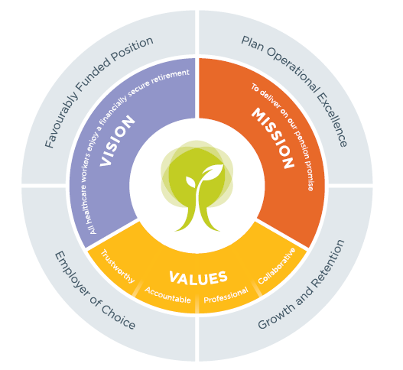
HOOPP’s Vision, Values & Mission 2010 – 2012 Strategic Direction

Slide 6
IT&FS Vision & Mission
My Commitment to You
Provide you with the support, tools and resources to deliver on our Vision and Mission
Provide you with clear communication, direction and guidance on HOOPP’s Strategic Priorities
Provide you with clear communication, direction and guidance on the IT&FS strategies

Slide 7
IT&FS Vision & Mission
My Commitment to You
Provide you with an environment that ensures that you are engaged, innovative and satisfied with your work
Lead by example the vision, mission and HOOPP values

Slide 8
IT&FS Vision & Mission
“Respect your fellow human being, treat them fairly, disagree with them honestly, enjoy their friendship, explore your thoughts about one another candidly, work together for a common goal and help one another achieve it”. ~Bill Bradley

Slide 9
IT&FS Vision & Mission
“Teamwork is the ability to work together toward a common vision. The ability to direct individual accomplishment toward organizational objectives. It is the fuel that allows common people to attain uncommon results.” ~Andrew Carnegie

Slide 10
IT&FS Vision & Mission
My Expectations of You
Deliver on our vision and mission while exuding the HOOPP values
Be accountable for your actions – take responsibility for your actions
Respect your co-workers

Slide 11
IT&FS Vision & Mission
My Expectations of You
Work in a collaborative manner as a team
Provide solutions to challenges as they arise…because they will

Slide 12
IT&FS Vision & Mission
My Expectations of You
Do not get frustrated
Stay focused on delivering our strategic priorities
Deliver on your commitments – if you can’t, let your client know

Slide 13
IT&FS Vision & Mission
My Expectations of You
Set smart goals for yourself
Push yourself to be better
Do NOT say “its not my job…call so and so in IT Operations they will be able to help you”

Slide 14
IT&FS Vision & Mission
“The secret of getting ahead is getting started. The secret of getting started is breaking your complex overwhelming tasks into small manageable tasks, and then starting on the first one.” ~Mark Twain

Slide 15

HOOPP - Best Place to Work
HOOPP one of Canada’s 10 Most Admired Corporate Cultures
Notes:
HOOPP one of Canada’s 10 Most Admired Corporate Cultures
I am delighted to announce that out of 276 eligible nominated organizations and 98 finalists, HOOPP has been chosen as a regional winner by Waterstone Human Capital’s award for Canada’s 10 Most Admired Corporate Cultures. This is an exceptional achievement for HOOPP.
Cultural excellence is a key component of our strategic plan. By instilling pride in our employees, we drive the engagement and commitment needed to achieve all our strategic objectives and become an employer of choice.
HOOPP’s submission for this award was voted on by Canada’s 10 Most Admired Corporate Cultures Board of Governors. Criteria that were considered include:
Vision and leadership
Cultural alignment, measurement and sustainability
Rewards, recognition and innovative business achievement
Corporate performance
Corporate social responsibility
The award is a seal of approval by Canada’s leadership community and solidifies HOOPP’s culture as one of our employee value propositions for sustaining a competitive advantage.
HOOPP will celebrate at an awards reception being held on October 19 in Toronto. Along with the other regional winners, HOOPP will also be considered for Waterstone’s national award.
Each and every one of you plays an important role in making HOOPP a great place to work. Thank you for creating a culture that we can all be proud of.
John
----------------------------
For more information about Canada’s 10 Most Admired Corporate Cultures, visit:
www.canadasmostadmired.com

Slide 16
Main Divisions & IT FS Structure

Slide 17
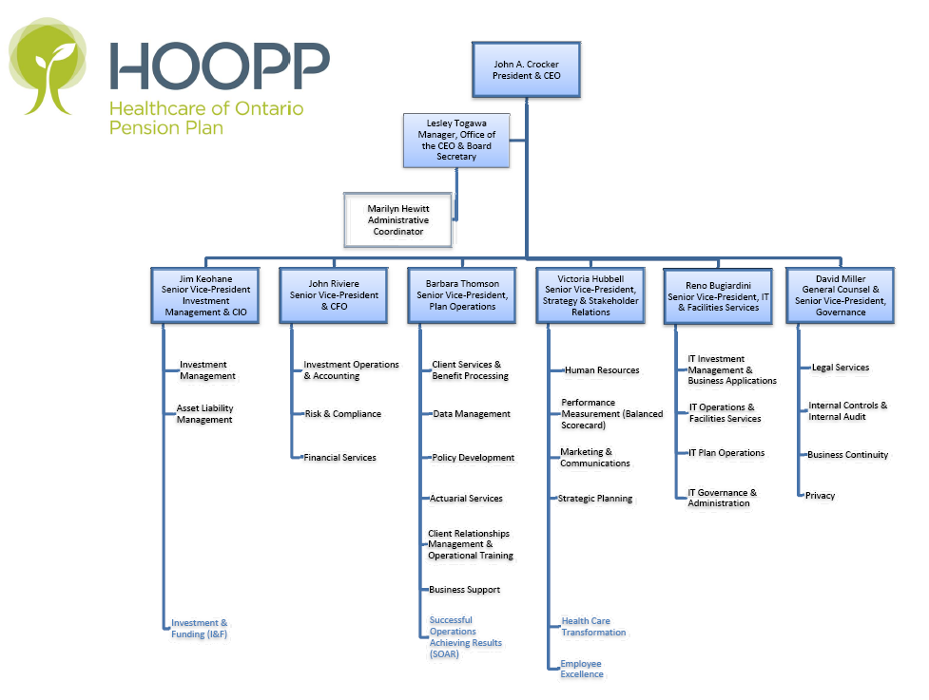
Main Divisions & IT FS Structure

Slide 18
Main Divisions
Office of the President & CEO
Information Technology & Facilities Services
IT Investment Applications
Finance
Investment Operations & Accounting
Securities Accounting
Treasury
Investment Mgmt & Reporting
Investment Data Mgmt
Compliance & Risk
Operational Risk & Controls
4) Investment Management
Public Equities
Fixed Income and Derivatives
Short Term/Cash & FX
Capital Partners
Real Estate

Slide 19
IT & Facilities Services
Investment Applications
Business Applications
IT Plan Operations
IT Governance
IT Operations & Facilities

Slide 20
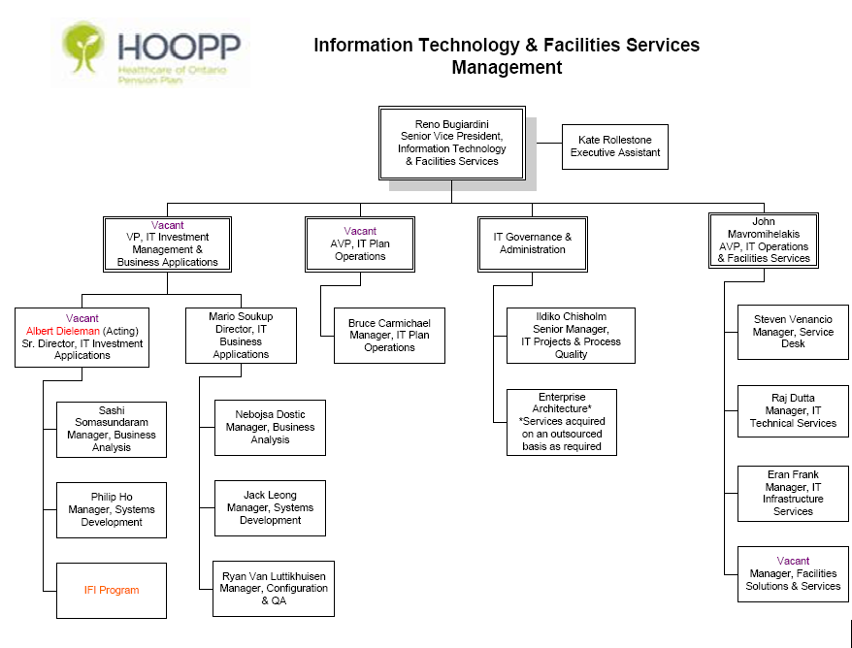
IT Group
Investment Systems
Business Applications
IT Plan Operations
IT Governance
IT Operations & Facilities

Slide 21
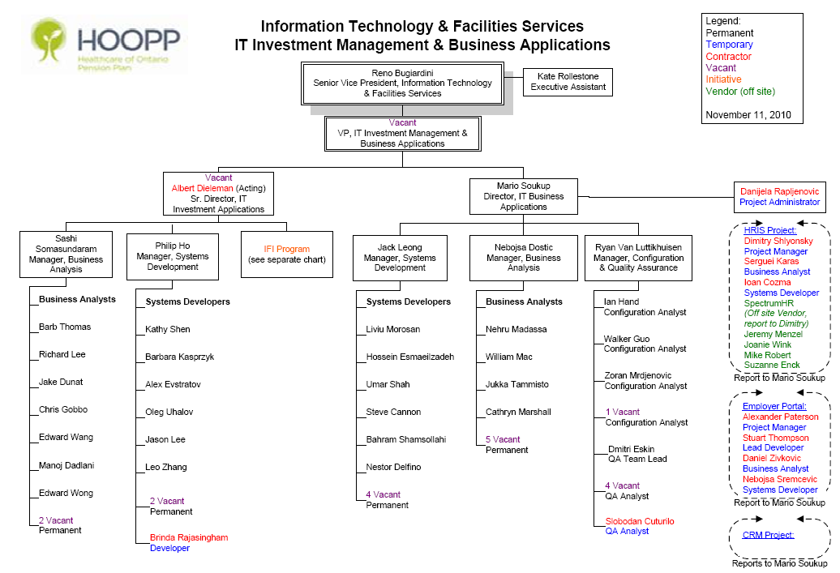

Slide 22
Front Office

Slide 23
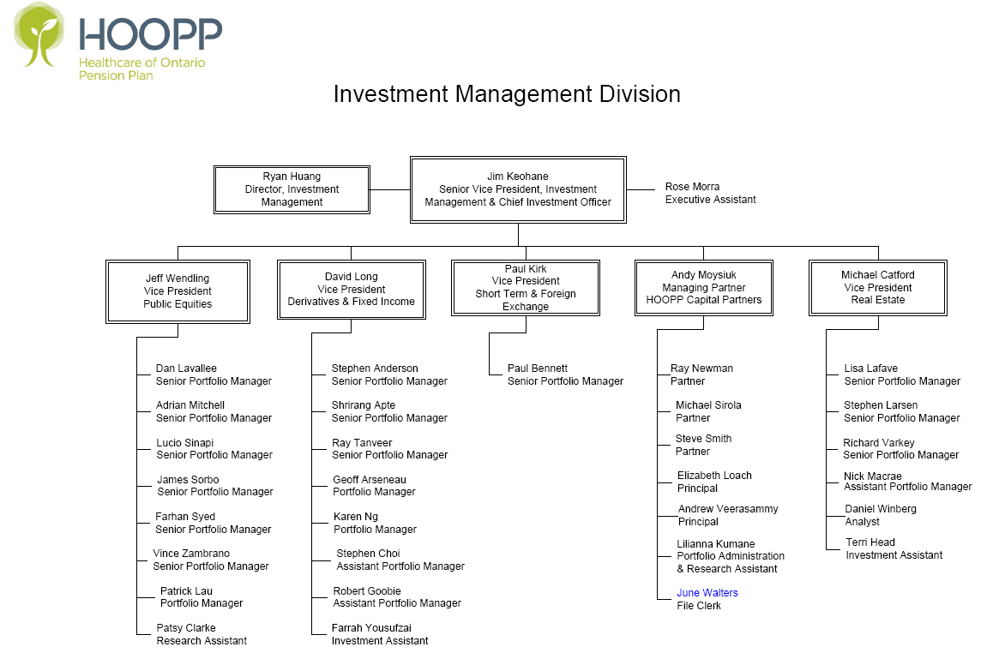

Slide 24
Business Units & their relationships to Investment Applications
Front Office – Public Equities
Head – Jeff Wendling
Manages HOOPP’s equity portfolio of Canadian, US and Non North American
Key tools: Bloomberg POMS, Reports (Reporting Services Reports, SCD Position Analysis), MSCI Barra, Weight Sheets

Slide 25
Business Units & their relationships to Investment Applications
Front Office – Fixed Income and Derivatives and ST&FX
Head – David Long and Paul Kirk
Manages HOOPP’s Fixed Income, Short Term/Cash, FX & Derivative Portfolios
Key Tools: Bloomberg POMS, Reports (i.e. Currency Hedge, Asset Mix, Securities Availability, etc.)

Slide 26
Business Units and their relationship to Investment Systems
Front Office – Real Estate
Head – Michael Catford
Manages HOOPP’s Real Estate Portfolio
Key tool: MRI
Front Office – HOOPP Capital Partners
Manages HOOPP’s private equity portfolio
Head – Andrew Moysiuk
Key Tool: Private-I application

Slide 27
Finance: Middle Office

Slide 28
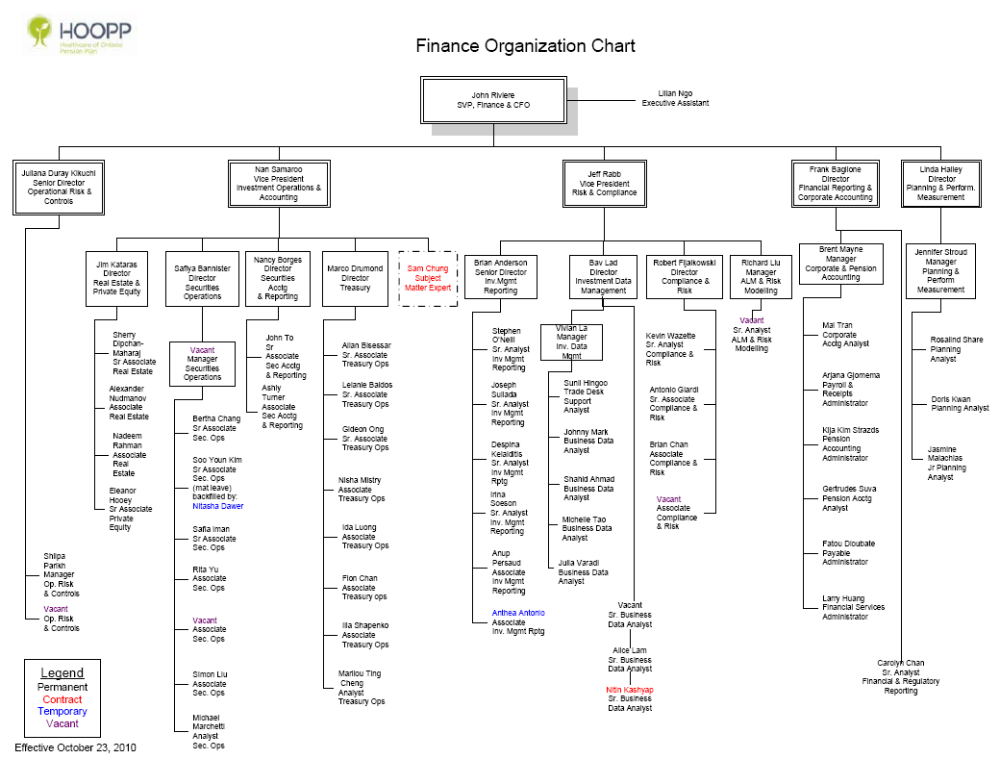
Middle Office

Slide 29
Business Units and their relationship to Investment Systems
Middle Office – Investment Data Management
Head – Bav Lad
Performs the function of the data steward, performs daily integrity checks on external data imports and internal data movements (between systems)
Key tools: Eagle Pace (Reporting, SMF & Entity Management, Pace Data Hub), SimCorp Dimension (Data Setup), Message Center

Slide 30
Business Units and their relationship to Investment Applications
Middle Office – Compliance & Risk (C&R)
Head – Robert Fijalkowski
Two key functions performed by C&R
Measures risk of HOOPP’s portfolio and compliance to guidelines (IP&G – Investment Policies & Guidelines)
Calculation of all Pricing (that are not exchange traded)
Investment Systems has active interaction with C&R
Delivering data in analysis friendly format
Automate calculation of prices
Key Tools: FINCAD Pricing, Compliance Dataset, Credit Exposure Engine

Slide 31
Business Units and their relationship to Investment Systems
Middle Office – Investment Management Reporting (IMR)
Head – Brian Anderson
Two key functions performed by IMR
Measures Performance (P&L) of HOOPP’s portfolio and individual managers
Generates key Total Fund Reports (i.e. Asset Mix)
Key Tools: Eagle Pace (for reporting such as Asset Mix, Currency Hedge, etc.), P&L DataMart

Slide 32
Finance: Back Office

Slide 33
Middle Office

Slide 34
Business Units and their relationship to Investment Applications
Back Office – Security Operations
Head – Safiya Bannister
Key functions performed
Manual Trade Entry, processing & reconciliations
Integrations with derivatives brokers/counterparties (payments, confirmations, etc.)
Key tools used: SimCorp Dimension, Reporting Services Reports

Slide 35
Business Units and their relationship to Investment Applications
Back Office – Treasury
Head – Marco Drumond
Key functions performed
Deals with Custodian (NT) with cash, settlements & recons
Supports Front Office with their Treasury Processing & Reporting needs (i.e. Securities Lending, Collateral Management, Repos, Cash Forecasting & Management)
Deals only with Equities, Fixed Income, FX, Short Term & Cash Instruments
Key Tools: SimCorp Dimension, Pace Reporting, SSI (SSC Net for Settlements)

Slide 36
Business Units and their relationship to Investment Applications
Back Office – Accounting
Head – Nancy Borges
Key functions performed include
Investment Accounting & reconciliations
Responsible for fund’s financial reporting
Key Tools Used: SimCorp Dimension, Reporting Services Reports

Slide 37
Business Units & their relationship to Investment Applications
Back Office – Real Estate and Private Equity
Head – Jim Kataras
Key functions performed
Handles all back office functions of real estate and private equity
Key tools used: MRI, Impact, Priviate-I

Slide 38
Main Investment Systems

Slide 39
Main Systems within Investment Systems
Portfolio Management & Accounting: SimCorp Dimension
Transaction Entry or Import
Position keeping (book value calculations, Gain/Loss calculations, admin processing)
Investment Accounting (GL Postings, Trial Balance, Income Statements)
Reporting
Investment Data Warehouse: Eagle Pace
Fed from SimCorp Dimension & external data (vendor data, custodian, brokers)
Key Total Fund reports run from Eagle Pace (using Reporting Services)
Trade Order Management: Bloomberg POMS
Equities & Fixed Income Trade Entry
Imports Transactions into SimCorp Dimension
Other Key Tools
Pricing Engine: FinCad
Fixed Income & Equity Trade Settlement (custom built): SSI

Slide 40
Next Steps for IT - IA

Slide 41
Next Steps for IT IA
IFI program (and PRP Project) is complete
Automated existing business functions
PL, Accounting were both excel-based before
Significant increase in complexity
SimCorp is 5x more complex than Portia
More frequent patches/upgrades for SimCorp
SimCorp requires an upgrade 1x per year
Business expects patches throughout the year, based on demand
More reliance on SimCorp application
In the prior model, we relied heavily on excel and end-user solutions to meet our business needs
In that model, IT support was only required for the core application
In the new world, IT will now need to understand/support all aspects of the business (e.g. trade processing) in order to properly support the systems

Slide 42
Next Steps for IT IA (cont’d)
Continuous Improvements
“Pent-up” demand for last 2 years
It is expected that our business partners will continue to demand more/continual improvements to the Investment Application infrastructure
Business groups supported
5 VPs (Nan S, Jeff W, Paul K, David L, Jeff W)
8 Directors (Juliana D, Brian A, Bav L, Robert F, Brian A, Marco D, Safiya B, Nancy B)
50-60 Business staff – Front/Mid/Back
Investments Growth
HOOPP’s investment business will become more complex
We must be positioned for support/growth

Slide 43
Next Steps for IT IA (cont’d)
Reviewing IT IA Service model → to better align with business demands
Business has changed due to the IFI project → IT IA will need to grow to support this change
Large influx of new staff to support business
Desire from business to expand use of IT solutions

Slide 44
The End
Questions???

